Slide 1
Empower Lunch Session
IT Catalog

Slide 2
Agenda
Introductions
Catalogs: Old and New
Catalogs: Our future
How to Help
Q&A

Slide 3
Polling Information
PollEv.com/noelt672

Slide 4
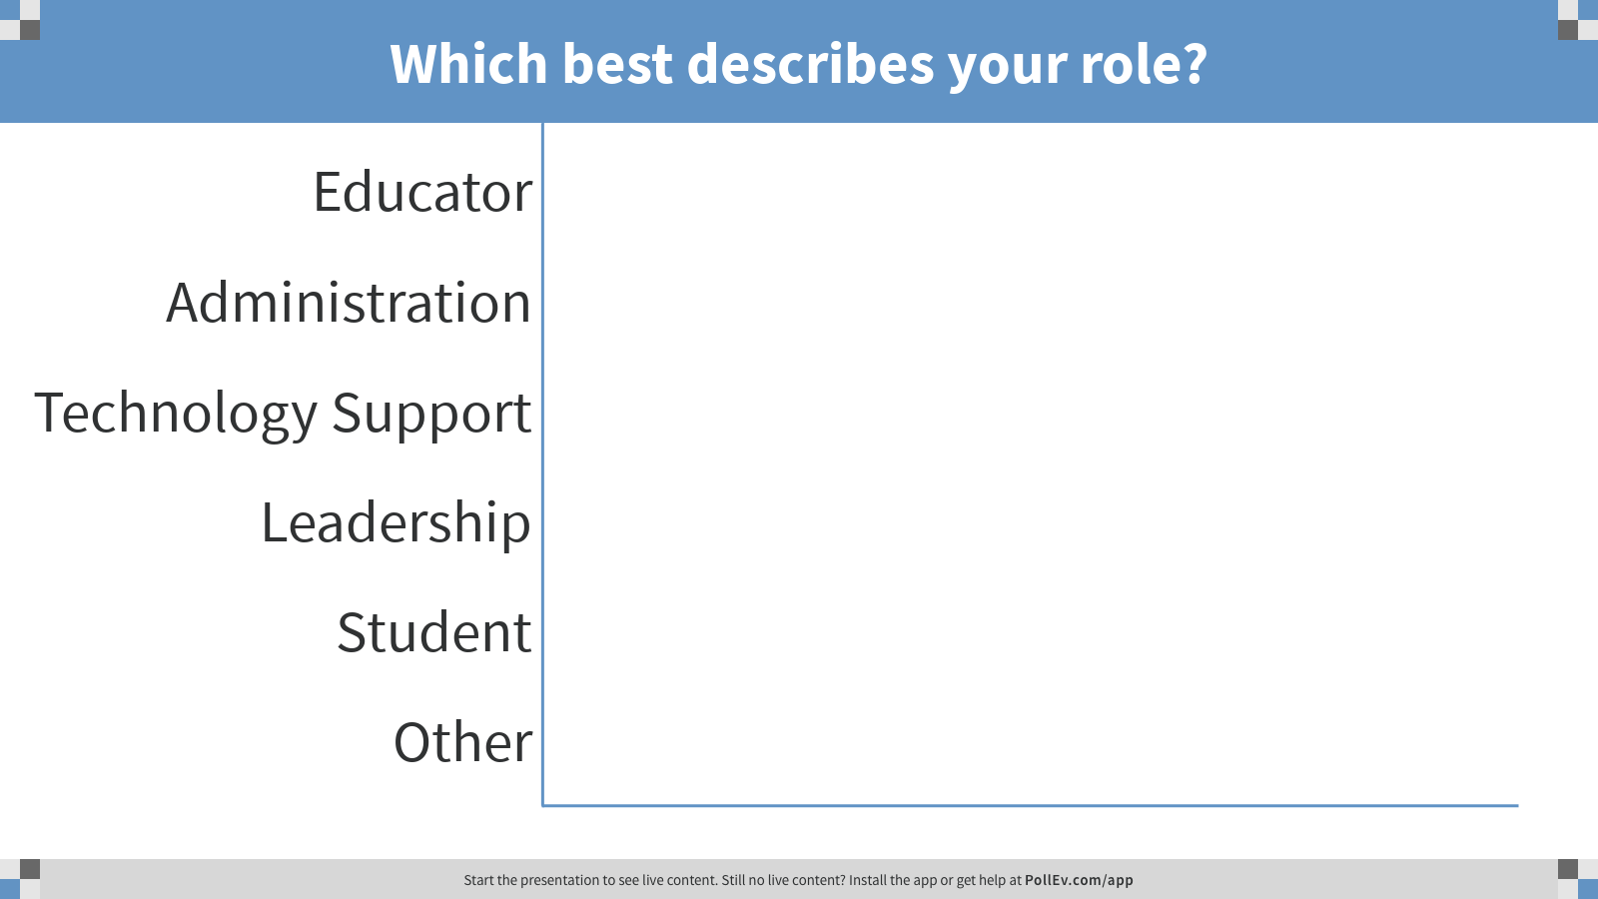

Slide 5
Introducting Your Catalog v.2 Core Team
Barbara Trainor: Manager, Products & Services Readiness
Abi Collins: UX Analyst
Matthew McDaniel: Communications Coordinator
Samantha Becker: Executive Director, Creative & Communication
Noel Thiesing: Executive Director, Engagements & Consulting Services

Slide 6
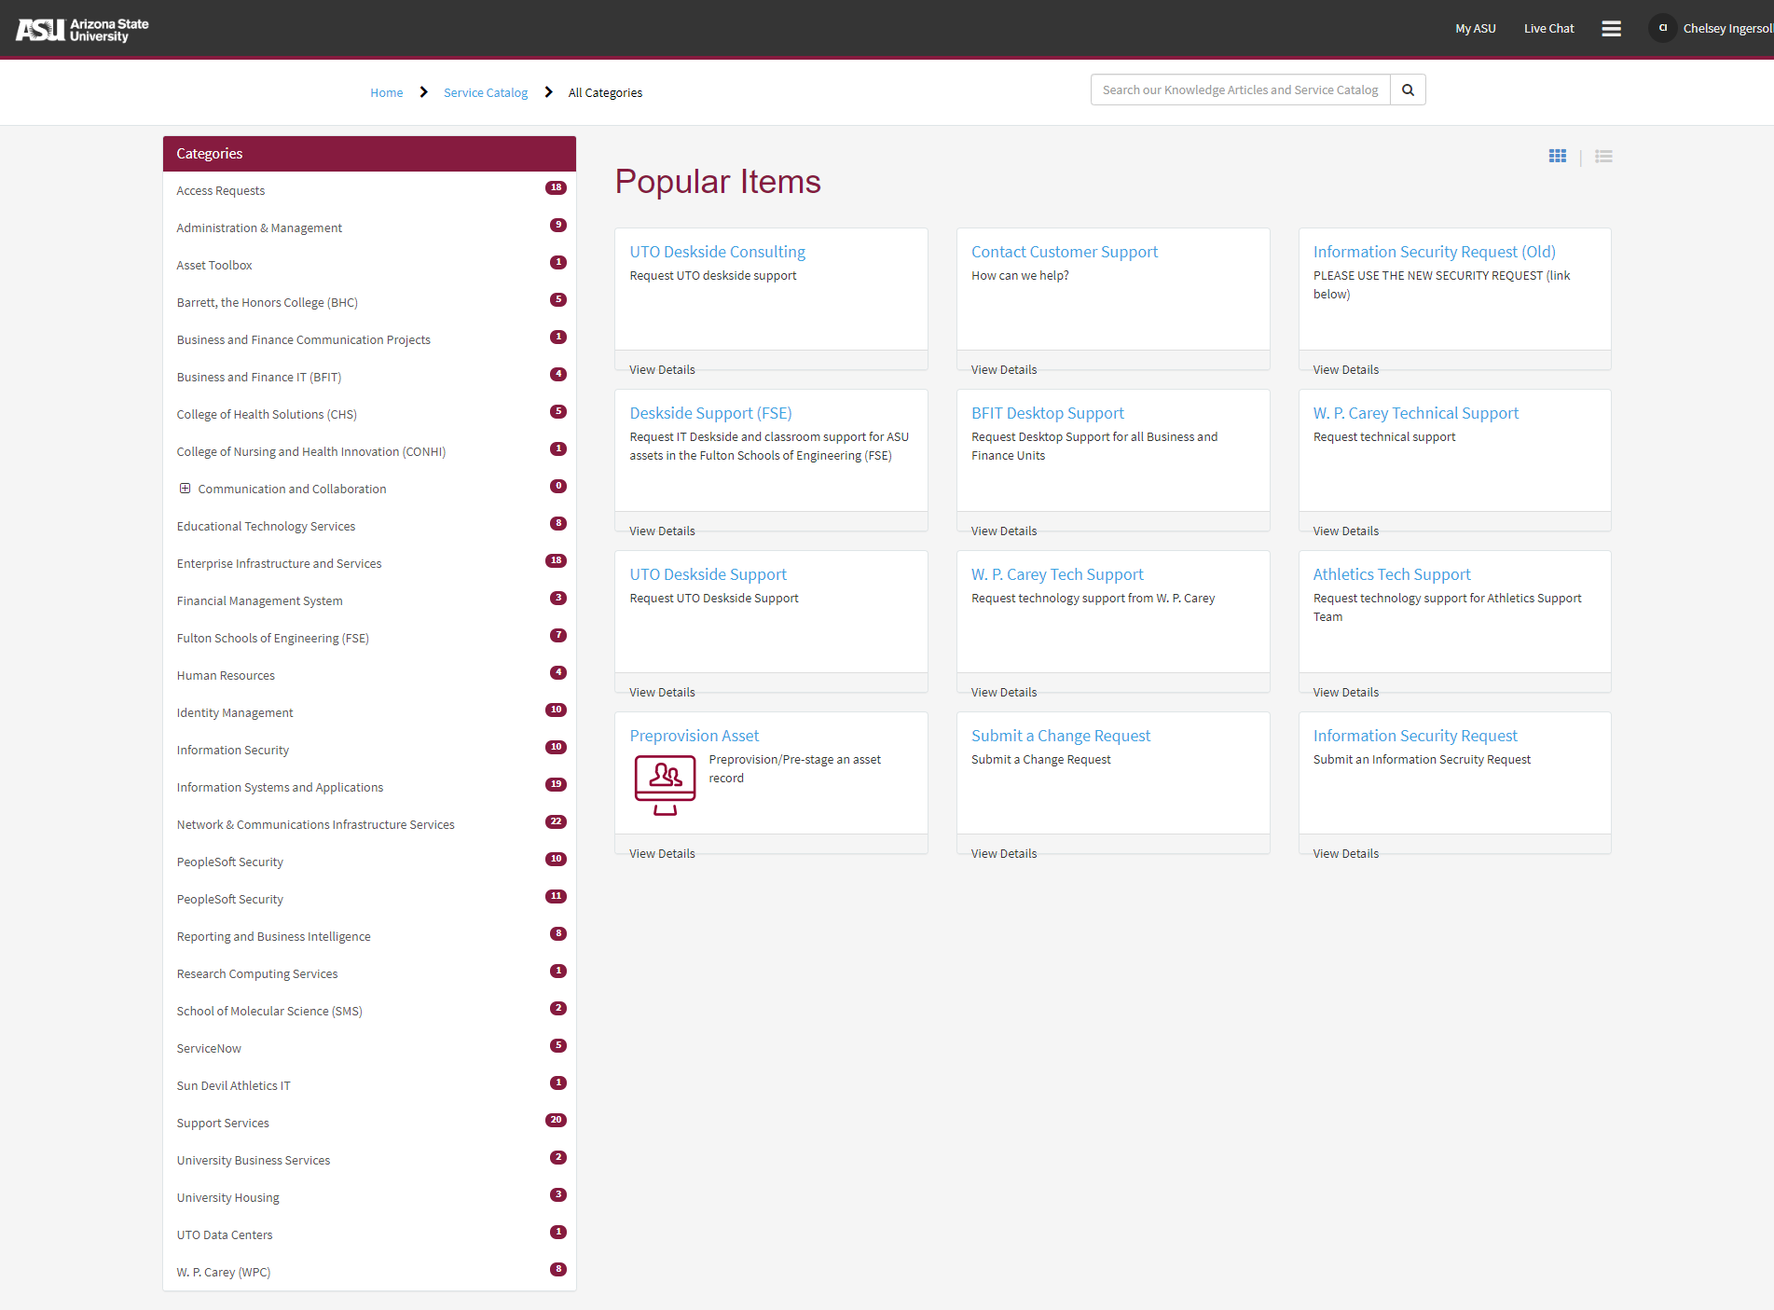
Where We Started
A very impressive list of forms.

Slide 7
A catalog is more than...
A list of forms
An exhaustive list of activities
Notes:
Thinking about “just in time ordering”

Slide 8
A catalog allows you to:
Find & request IT services
Compare offerings

Slide 9
The great migration
Select service names
Select service owners
Map the current forms to services
Create content (offerings, kbs, etc)
Writing, writing, and more writing
Iterate early and often

Slide 10
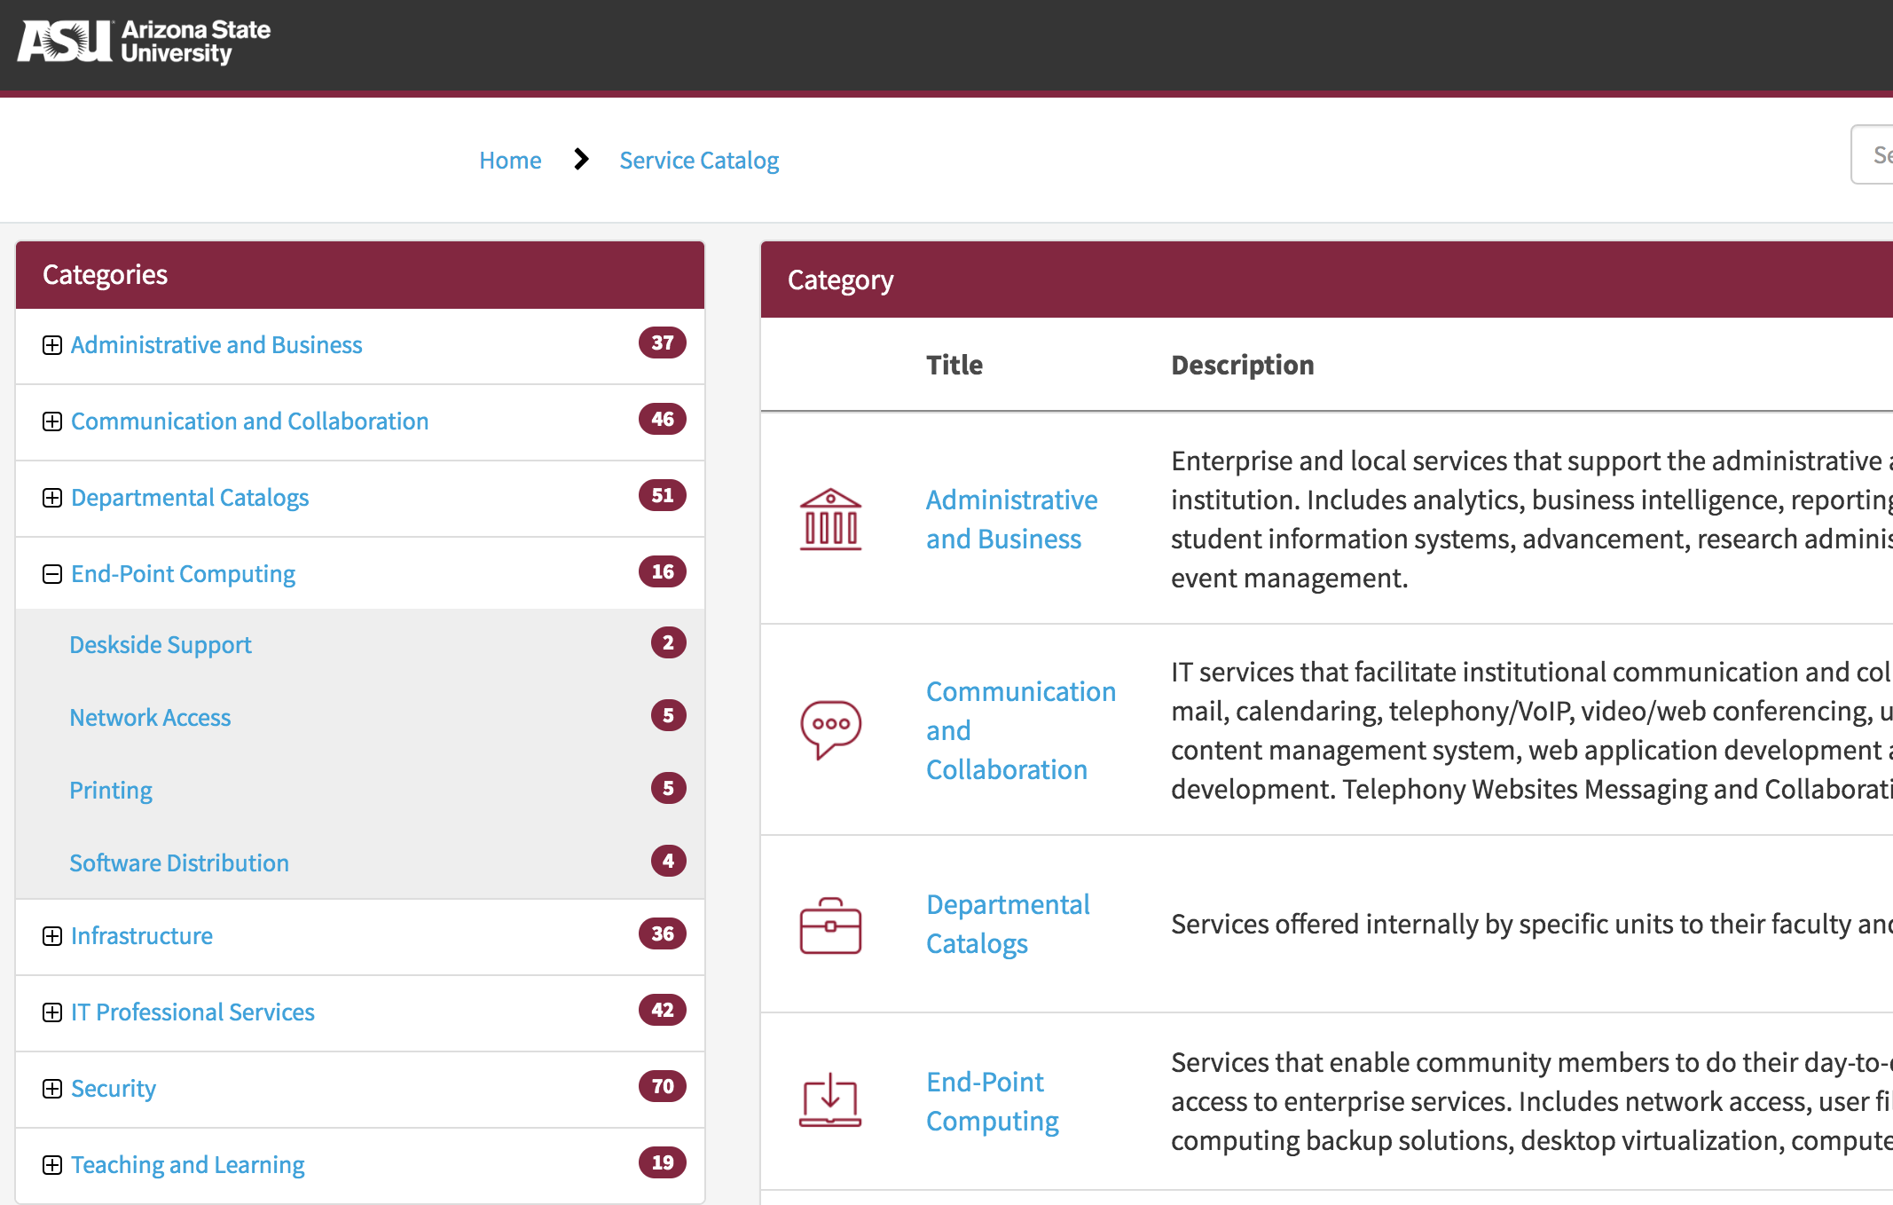
Catalog MVP
Logical grouping of offerings by services & service categories.

Slide 11
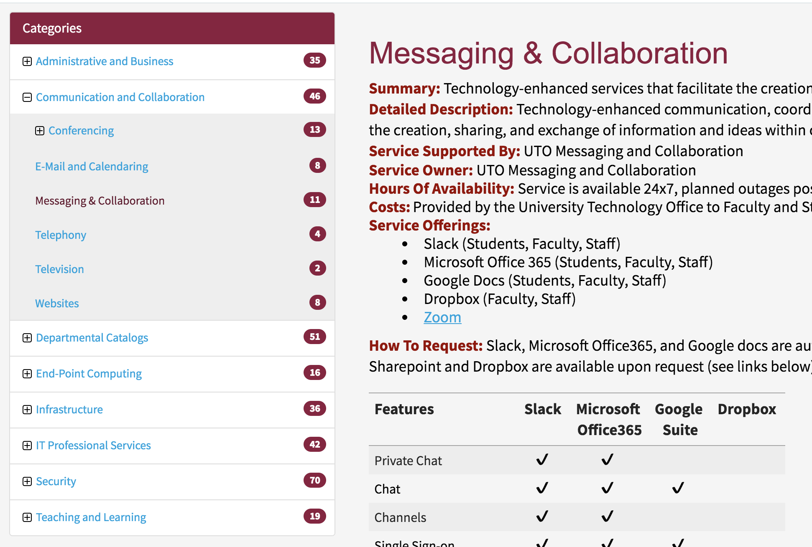
Catalog MVP
Descriptions of the services with a comparison of offerings and features.

Slide 12
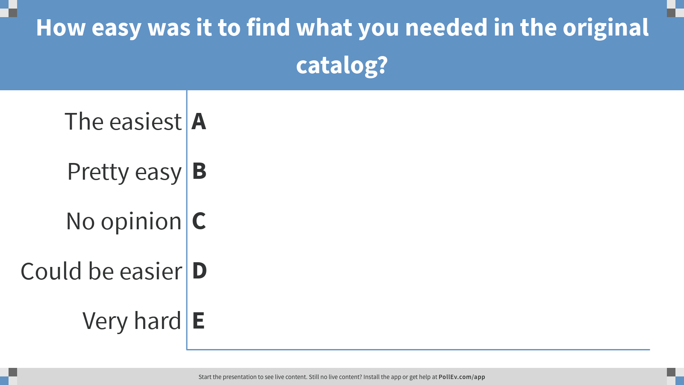

Slide 13
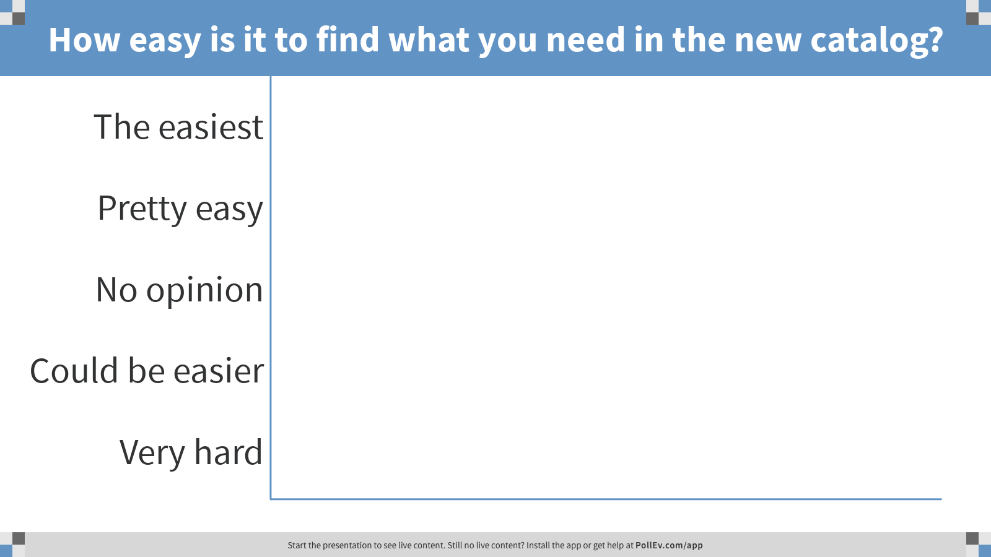

Slide 14
Our Catalog Future

Slide 15
How to Help

Slide 16
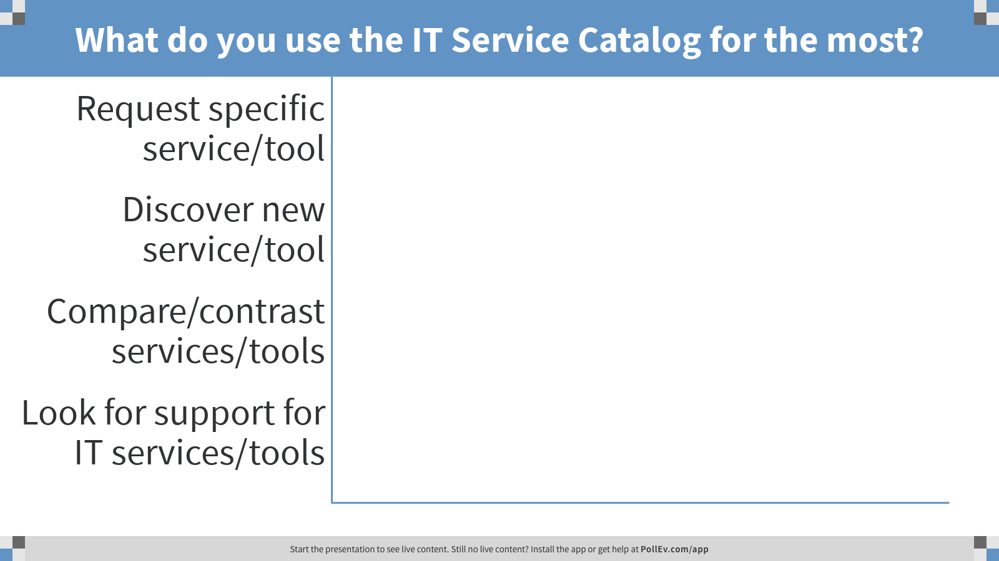

Slide 17
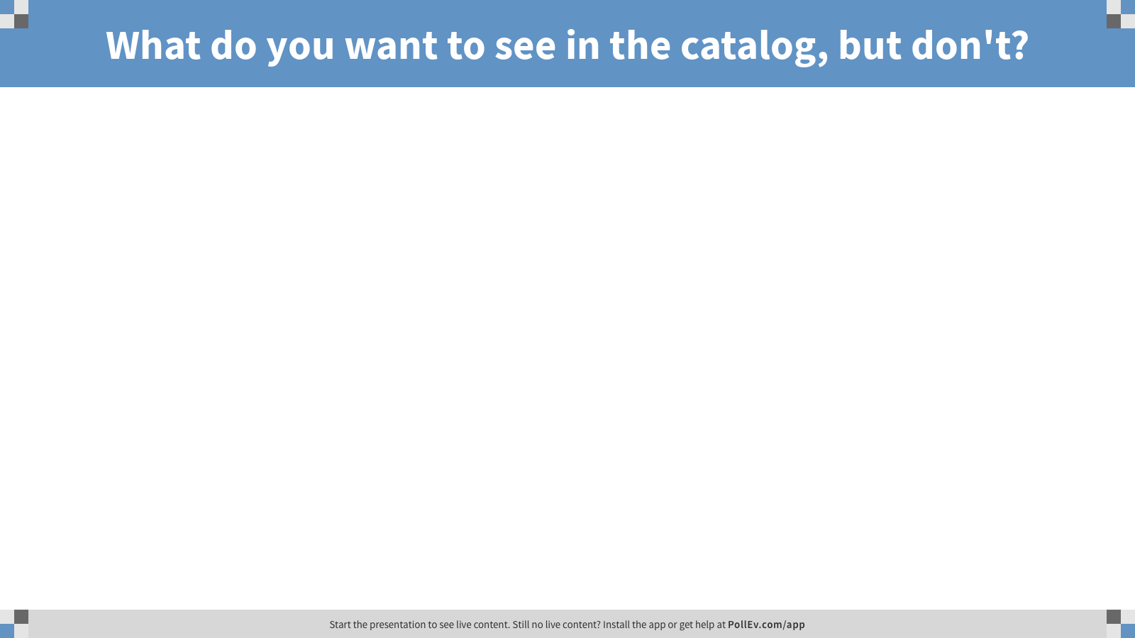

Slide 18

Discussion

